Slide 1
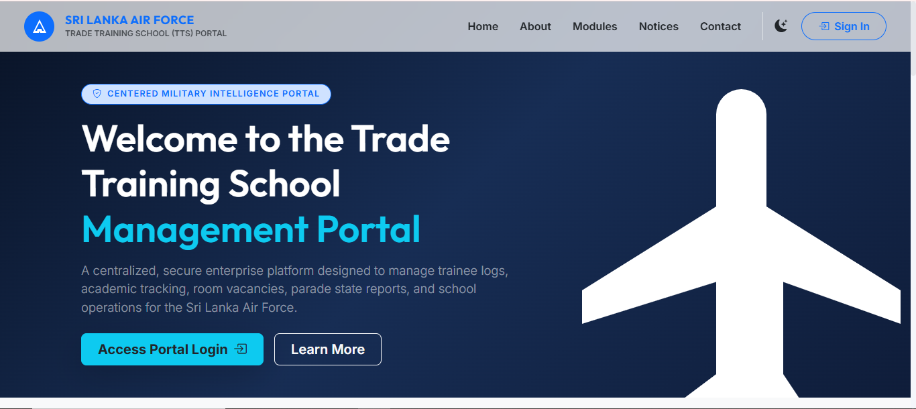

TRADE TRAINING SCHOOL
MANAGEMENT PORTAL

Slide 2




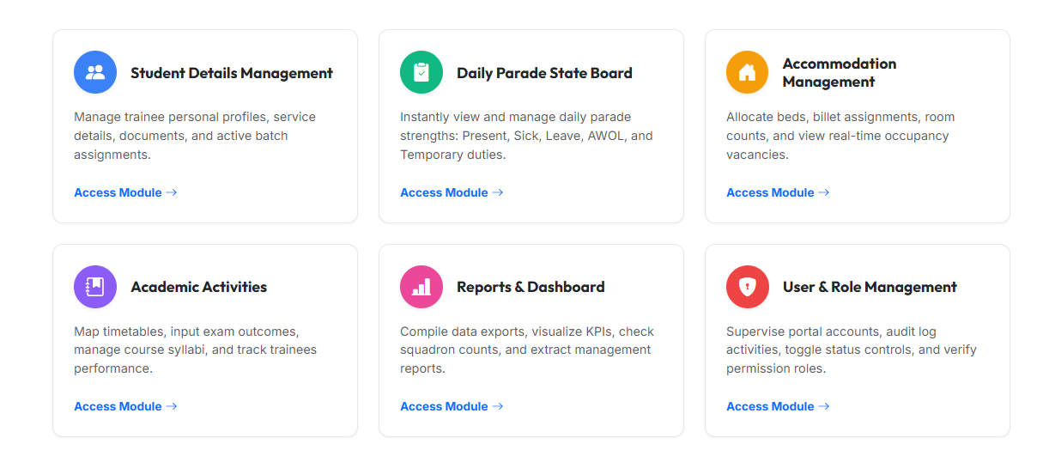
Pre-Digitization Service Vulnerabilities
Eliminating administrative delays, fragmented paper registers, and unlinked squadron records.
Fragmented Rosters
Delayed Strength Return
Unsynchronized State
Billeting Blind spots
Service records split across physical registries, personal workbooks, and local files.
Manual compilation across trade schools delayed morning state to the CO by hours.
Hospital admissions and AWOL cases failed to instantly lock classroom and exam rolls.
Paper billets logs caused bed over-allocation and untracked emergency locations.

Slide 3



Single Source of Truth (SSOT) Architecture
Standardizing all administrative, academic, and regimental data under one canonical data model.
01
02
03
Official Service Number Master
Instant Cross-Module Cascade
Chain of Command Access
Identity anchored strictly to unique Service Number. All marksheets, strength records, and conduct logs seal to this master identity.
Daily occurrences cascade school-wide. Morning parade sign-offs immediately sync lecture room registers, assessment rolls, and bed states.
Granular RBAC strictly mirrors service appointments. Least-privilege rules preserve non-repudiation and prevent unauthorized overrides.

Slide 4








Operating Model: 8 Seeded Military Appointments
Enforcing least privilege while keeping administrative duties aligned with physical appointments.
1. Super Admin
2. System Admin
3. Commanding Officer
4. Academic / OCT
Master system authority, security role definitions, and central database governance.
Service account provisioning, security log audit reviews, and backup verification.
Executive dashboards, live station strength return, parade reviews, and command analytics.
Trade structures, course master timelines, syllabus setup, examinations, and marksheets.
5. Discipline Section
6. Accommodation
7. Trade Instructors
8. Service Auditor
Morning muster submission, AWOL tracking, conduct logs, commendations, and occurrences.
Billet buildings, billets, bunk bed inventory (top/bottom), allocations, and vacancies.
Lecture room registers, lesson plans, and phase exam score entries.
Read-only operational dashboards, summary registers, and official reporting queries.

Slide 5






The Trainee Operational Lifecycle
Standardizing training milestones from trade setup to Passing Out.
STAGE 01
STAGE 02
STAGE 03
Course & Batch
Allocation
Enrollment
Define trade, course dates & intake batch.
Designate lecture room & assigned instructor.
Validate Service No
STAGE 05
STAGE 04
STAGE 06
Completion of course
Evaluations
Accountability
Phase testing & attendance monitoring.
Daily morning parade & night roll call.
Automated batch closure & permanent archive.

Slide 6



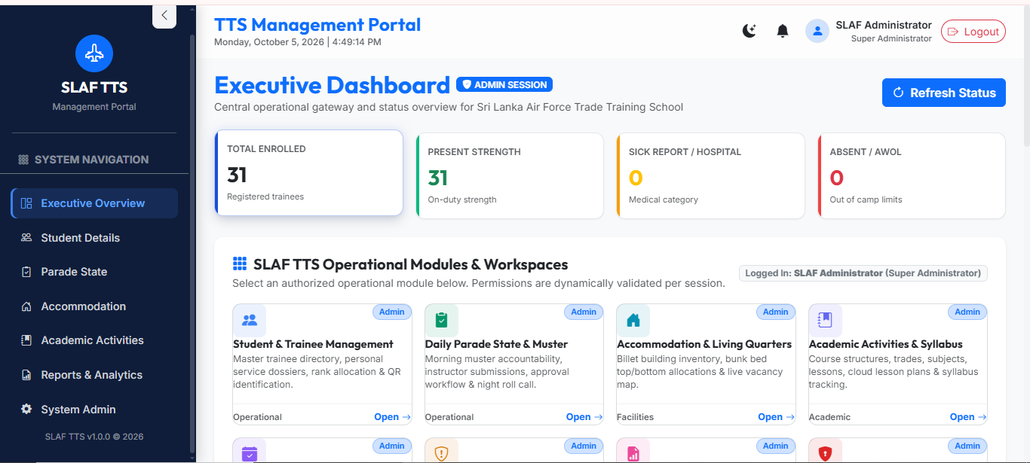
Executive Dashboard & Operational Strength
Consolidating real-time strength, academic indicators, and facility occupancy into an executive command view.
Live Strength Roll-Up
Academic Indicators
Facility Occupancy
Critical Alerts
Instant counters for approved on-parade personnel, sick quarters, hospital cases, leave, and detached duty.
Batch completion progress, active syllabus phases, average exam performance, and attendance rates.
Live visual occupancy rates across barrack buildings, billets, and vacant bunk positions for emergencies.
Immediate high-priority notifications dispatched to the CO upon confirmation of AWOL or hospitalizations.

Slide 7



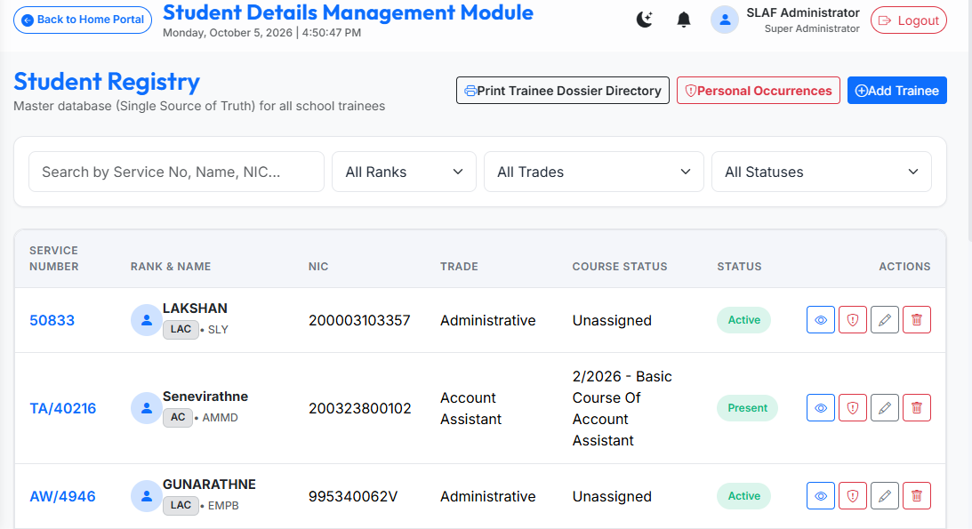
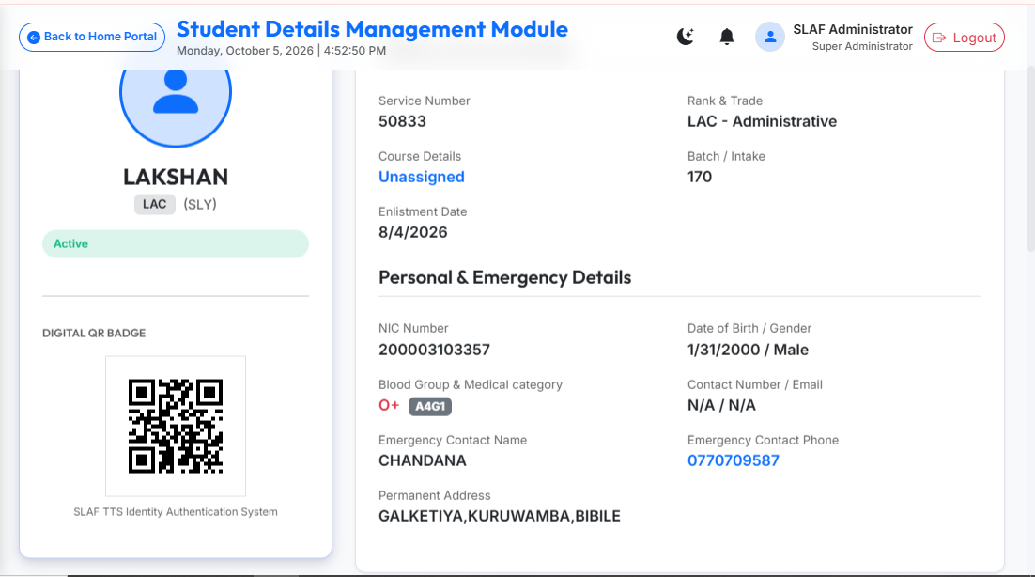
Trainee Master Dossier
A searchable, exportable master personnel record linking service identity, medical profile, and credentials.
Strict Uniqueness
Medical & Emergency
Classical Dossier PDF
Unique Service Number and NIC constraints enforce zero profile duplication across the SLAF database.
Medical category (A4G1), blood group, and emergency contacts accessible instantly during critical incidents.
Server-compiled official A4 PDF containing complete service record, academic marks, and conduct history.
A4 PDF Exportable

Slide 8


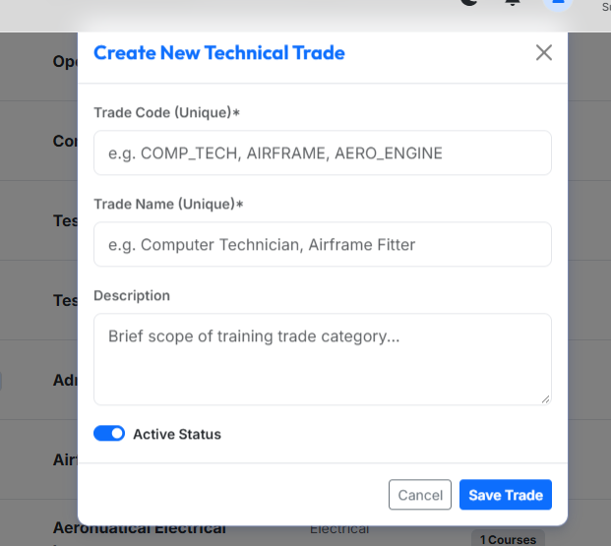
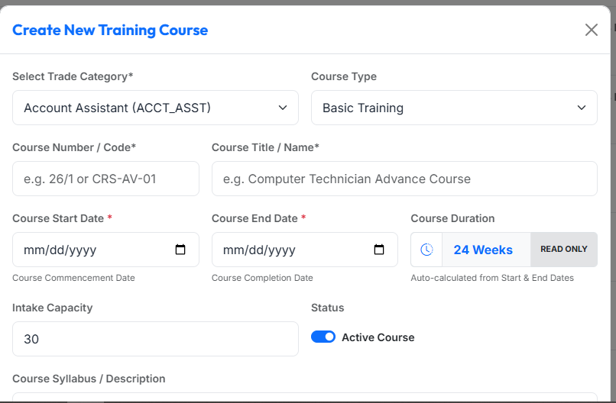
Course Management & Automated Batch Closure
Governing trade structures, classroom capacities, and automated course completion archiving.
Trade Registry
Batch Cohorts
Enrollment Guard
Automated Closure
Catalog vocational air force trades (Airframe, Safety Equipment, Engines, and courses.)
Link batches to designated physical classrooms, intake limits, start/end dates, and appointed instructors.
Trainees can only be registered into active courses; completed courses are blocked from new enrollments.
Daily background daemon automatically shifts expired courses to PASSED OUT, archiving historical records.

Slide 9



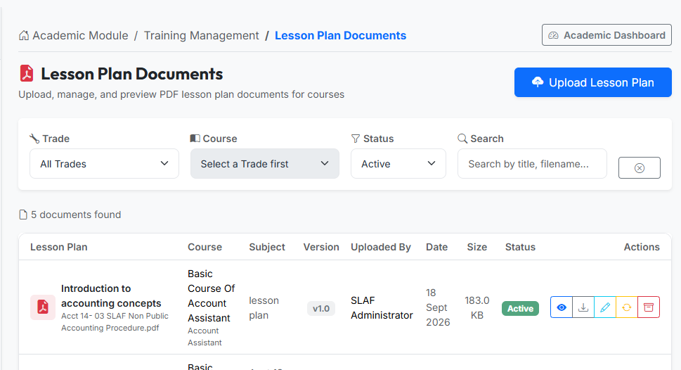
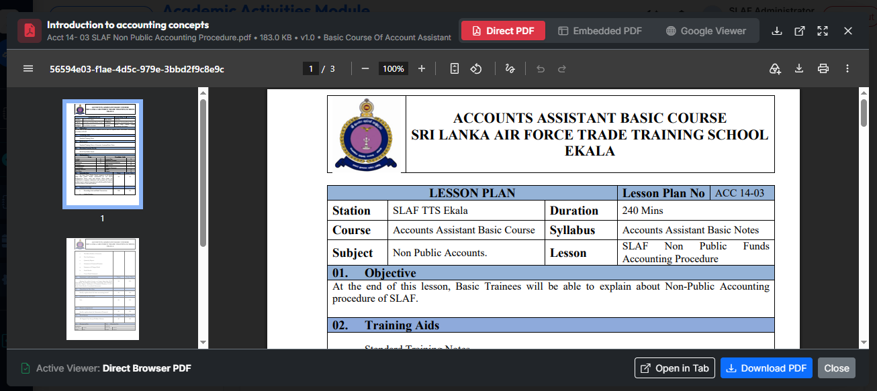
Syllabus Curation & Cloud Lesson Plan Storage
Direct linkage between theoretical syllabus guidelines, teaching units, and version-controlled assets.
Curriculum Breakdown
Cloudinary Integration
Upload Validation
In-App Preview
Courses break down into modular subjects and practical lessons with predefined teaching objectives.
Direct API integration stores versioned lesson plan PDFs in high-availability cloud storage.
Rigid MIME-type verification (application/pdf) and an enforced 20MB file-size ceiling.
Direct browser preview and secure download streaming for authorized trade instructors.
20MB Limit

Slide 10


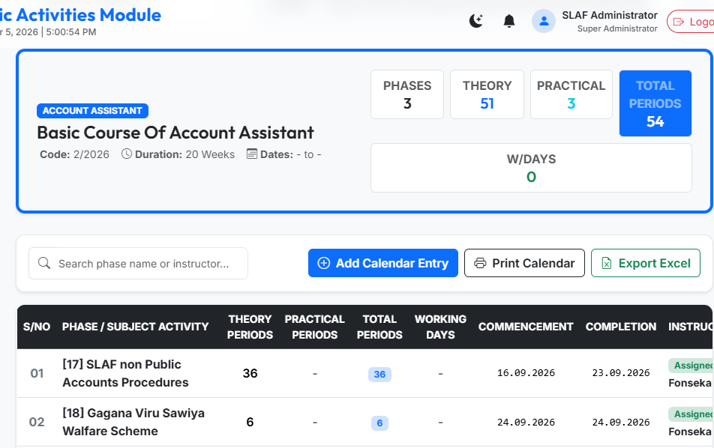
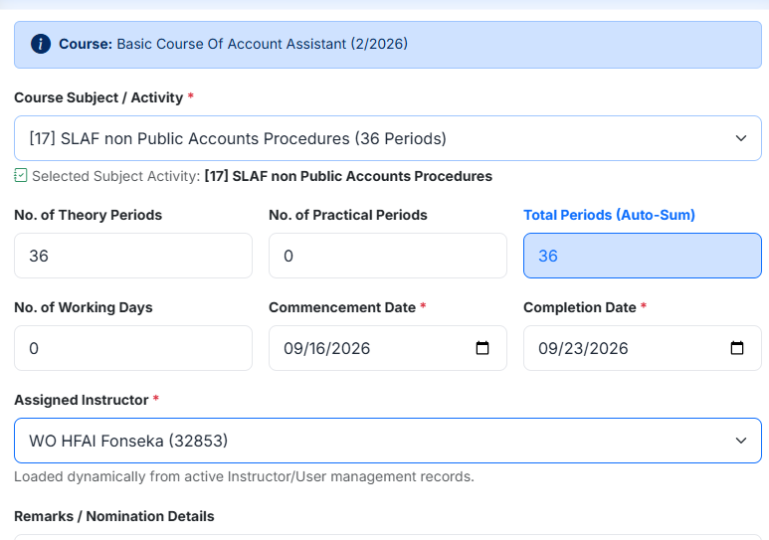
Course Calendar & Interactive Timetabling
Translating course plans into conflict-free, date-bound classroom and instructor schedules.
Phase Sequencing
Period Accounting
Full Calendar Grid
Establish sequential training phases with explicit commencement and completion date boundaries.
Track theory vs. practical periods and calculated working days against course duration requirements.
Interactive schedule grid offering month, week, and day views for school-wide resource coordination.

Slide 11
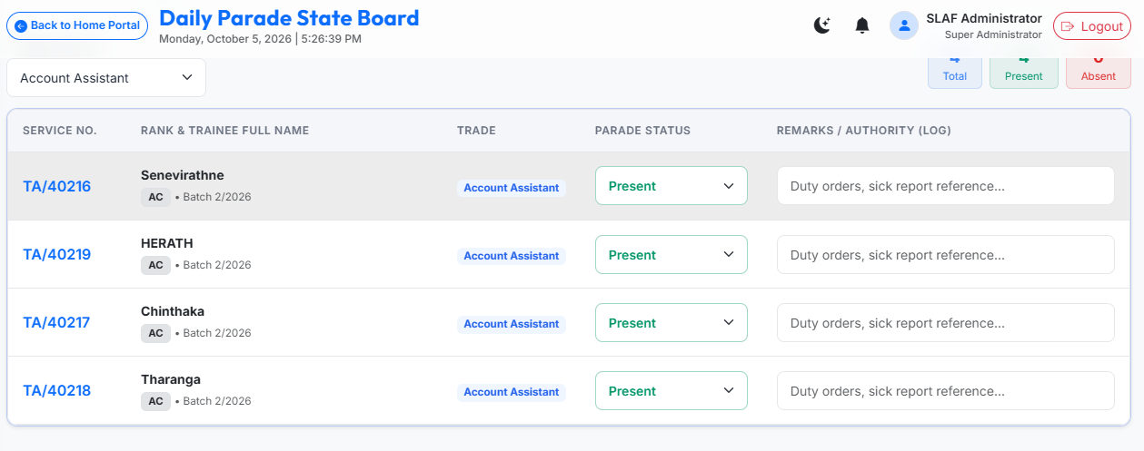
Morning Parade State
1
2
3
4
Nominal Roll Call
Auto-Routing
Instructor Review
Strength Locked
Discipline NCO loads active batch roll and marks statuses.
System automatically resolves designated course instructor.
Instructor verifies nominal roll and approves or returns.
Approved state updates official school daily strength.
SLAF STANDARD NOMINAL STATUS OPTIONS
Present
Sick Report
Hospital
Leave
Temporary Duty
Course Visit
Detached Duty
AWOL (Critical Alert)

Slide 12


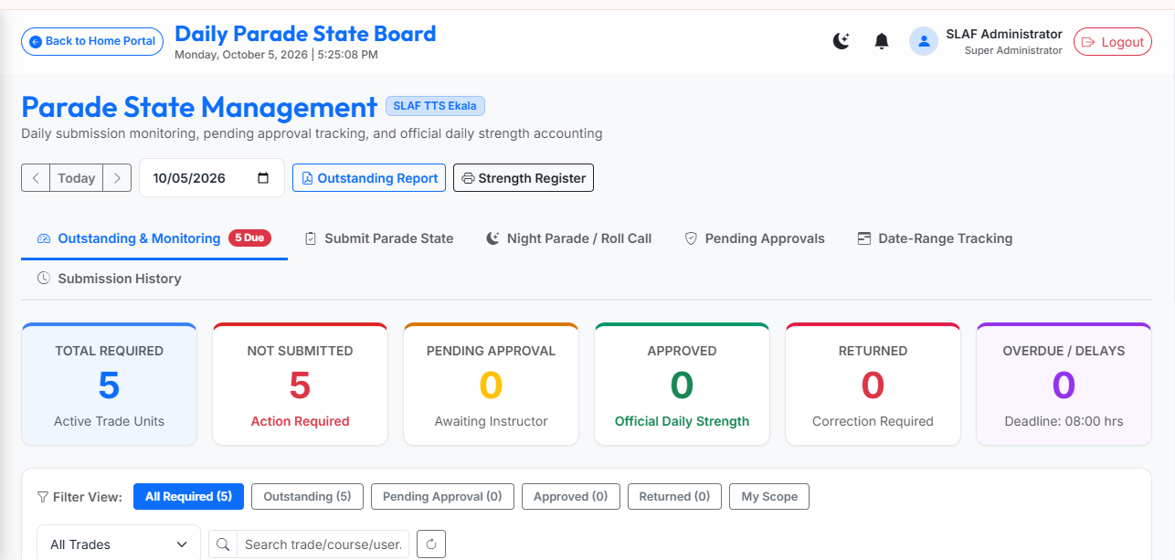
Instant Verification of Parade Guidelines and Incident Logging
Proactive command visibility over unsubmitted, pending, and returned parade states across all school trades.
State Machine Grid
Outstanding Tracking
Date-Range Auditing
Automated Pings
Tracks all trade schools across 4 states: Not Submitted, Pending Approval, Approved, and Returned.
Dedicated filter highlights trade squadrons failing to submit muster rolls before morning cut-off times.
Multi-day compliance history flags recurrent submission bottlenecks across training wings.
System dispatches reminder alerts to assigned instructors with pending review queues.

Slide 13



Classroom Attendance & Parade Synchronization
Automating full-day classroom attendance records from morning military parade states.
Full-Day Register
Automatic Cascading
System Remarks
Bulk Action Controls
Attendance applies to the entire training day, eliminating tedious period-by-period entry.
Approving parade state flags non-present trainees as Excused or Absent in classroom records.
Auto-synced records carry explicit audit stamp: 'Auto-synced on parade state approval'.
Instructors utilize 'Mark All Present' with individual toggle switches for rapid session roll call.

Slide 14


Examination Engine & Governed Eligibility Overrides
Connecting morning parade state to examination rolls.
Parade-Based Lock
Precise Grading
SLAF Grade Scales
Trainees on Sick Report, Hospital, Leave, or AWOL on exam date are automatically blocked from sitting.
Marks percentage is strictly computed as (obtained / max) * 100 with zero fabricated results permitted.
Automated classification: Distinction A+ (85%+), Distinction A (75%+), Credit B (65%+), Pass C (50%+).

Slide 15
Chronological Academic Progress Tracking
Evaluating longitudinal learning curves across sequential Phase Tests using live database queries.
Dynamic Line Chart
Summary KPI Metrics
Phase Audit Table
Zero Dummy Data
Chart.js visualization plots percentage scores (0–100%) against a 50% pass benchmark threshold.
Instant calculation of completed tests, cumulative average, latest score, peak, and lowest phase result.
Tabular breakdown showing Phase Test, Subject Code, Date, Max Marks, Score, Percentage, and Status.
If no marks exist, displays 'No Phase Test results available' rather than dummy estimates.

Slide 16
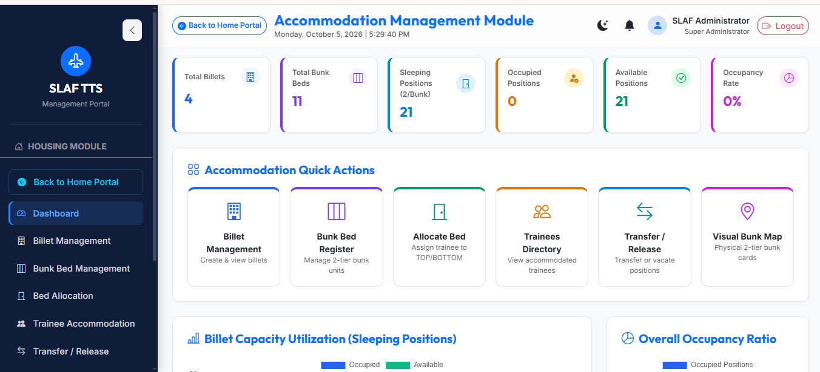
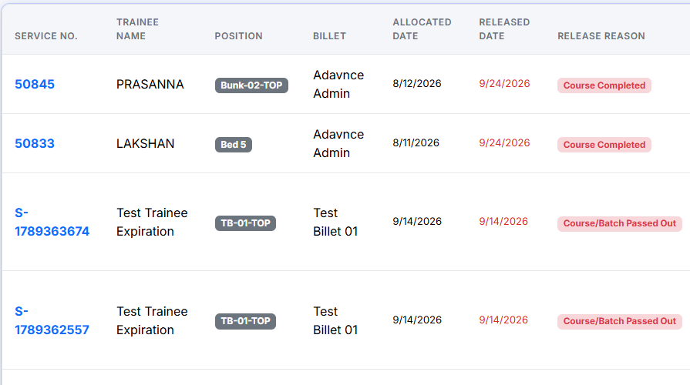
Accommodation: Bunk Bed Position Inventory
Managing billets down to the physical TOP and BOTTOM bunk bed position.
1. Building
2. Billet
3. Bunk Unit
4. Position
Billet /Block
Designated Billet / Floor
Two-Tier Frame Number
TOP / BOTTOM Slot
Allocate Position
Transfer billet
Vacate Bed
Assign one trainee per physical position. System strictly blocks duplicate allocation attempts.
Shift trainee to another billet or bed with full timestamped reallocation history logged.
Free bed position upon course completion or discharge; status automatically updates to Available.

Slide 17

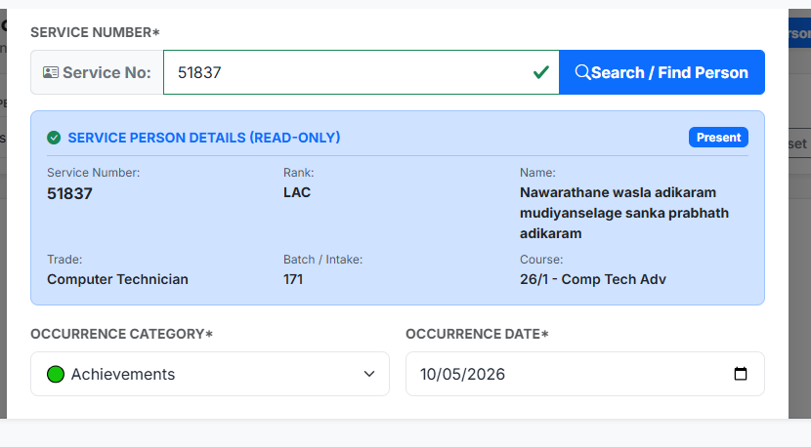
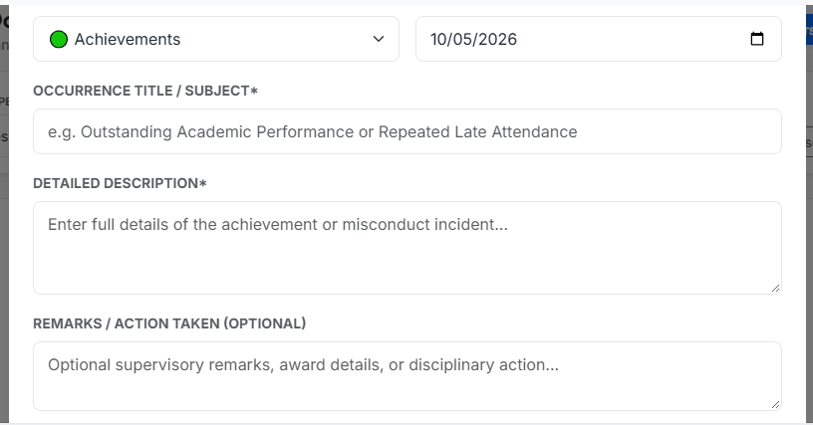
Personal Occurrence Reporting & Conduct Logs
Authoritative logging of trainee merits, commendations, misconduct, and disciplinary punishments.
Dual Classification
Fast Service Lookup
Dossier Embedding
Audited Deletion
Structured categorization into either ACHIEVEMENT (commendation, sports) or MISCONDUCT_OFFENSE.
Rapid indexing enables Discipline NCOs to record occurrences using exact Service Number search.
Logged occurrences immediately reflect within the trainee's profile and formal PDF dossier.
Occurrences cannot be purged by general users; soft deletion guarantees tamper-evident history.

Slide 18


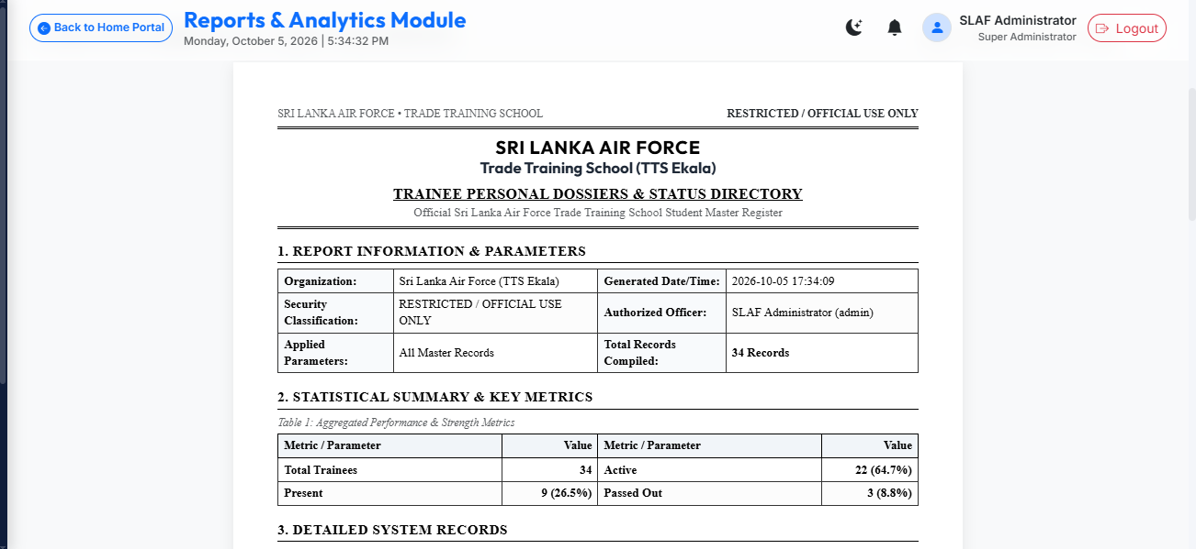
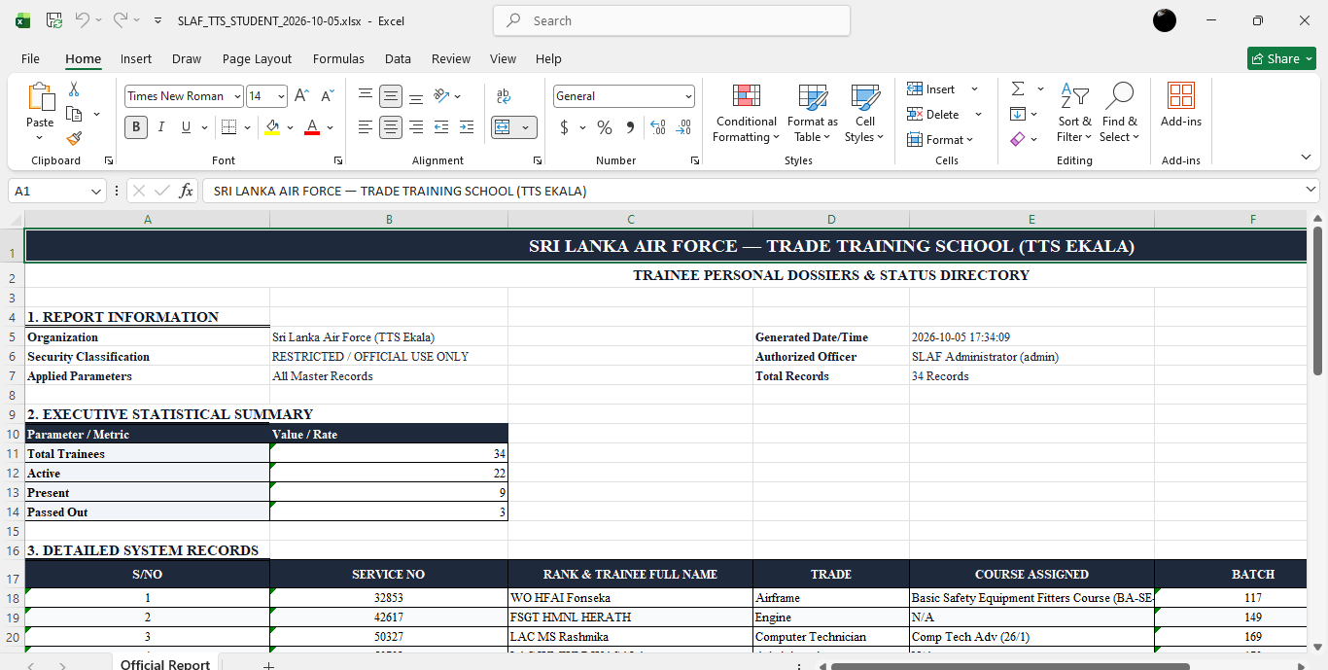
Enterprise Reporting: Publication-Quality SLAF Outputs
Server-side compiled documents replacing non-standard browser screen dumps.
PDF Engine (Report Lab)
Excel Engine
A4 portrait & landscape auto-paginated formats.
Native .xlsx workbooks with structured headers.
Official SLAF heraldic crest & masthead styling.
Filtered raw data exports for statistical analysis.
Table headers repeated automatically across pages.
Complete nominal rolls & daily strength registers.
Formal multi-tier signature endorsement blocks.
Formatted summary formulas & KPI blocks.

Slide 19

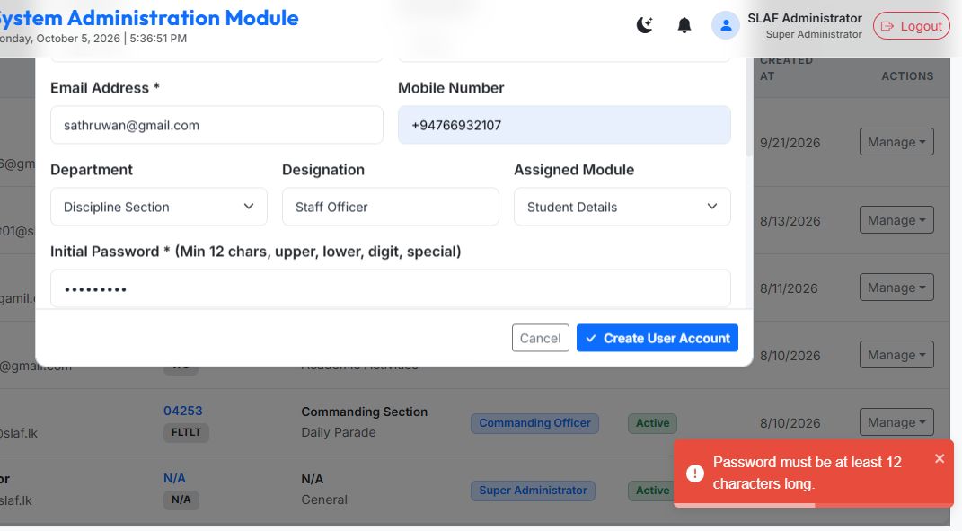
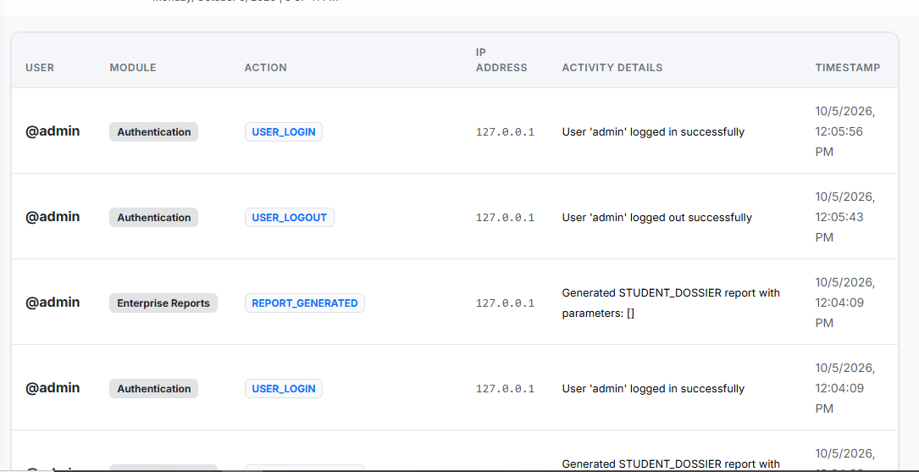
Security, RBAC & Immutable Audit Trails
Password Hygiene
Audit Evidence
Soft-Delete Safety
12-character minimum, mixed complexity, history check blocking last 5 passwords, and lockout after 5 failures.
Captures actor user ID, action code, client IP, browser user agent, before/after JSON states, and timestamps.
Critical military entities never undergo destructive hard deletes; historical records remain fully auditable.

Slide 20




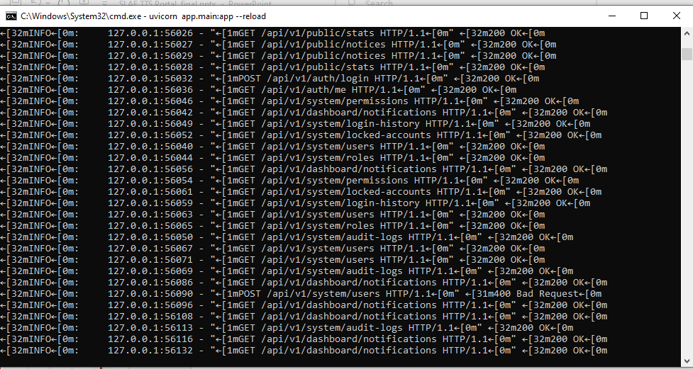
Technical Stack & Containerized Cloud Architecture
Frontend
Web & Reverse Proxy
API & Database
DevOps & Hosting
React 18 · Vite 5 · Bootstrap 5 · Chart.js · FullCalendar · Responsive UI.
NGINX reverse proxy · SSL/TLS termination · Rate limiting & Gzip compression.
FastAPI (Python 3.13) · SQLAlchemy 2.0 ORM · MySQL 8.0 (InnoDB) · Cloudinary.
Docker Compose orchestration · Oracle Cloud VPS (Ubuntu) ·

Slide 21
Delivering Operational Excellence Across Air Force Vocational Training
The TTS Management Portal replaces legacy manual records with an immutable, role-governed platform connecting trainees, instructors, and executive leadership into one operational baseline.

Slide 22
THANK YOU..!

